Slide 1
EmpowHer
EmpowHER: Empowering Girls for Corporate Excellence Technical Curriculum <Tech>

Slide 2
Agenda Week 1
Angular Installation and Setup
Introduction to Angular
Create a New Angular project
Git and GitHub Basics

Slide 3
Topic Week 1 : Installation And Setup
Pre-requisites
To set up Angular, you'll need to have Node.js and npm (Node Package Manager) installed on your machine.
Download and Install it from the link below.
https://nodejs.org/download/release/v16.20.1/node-v16.20.1-x64.msi
Install Angular CLI
The Angular Command Line Interface (CLI) is a powerful tool that makes it easy to create, build, and test Angular applications.
To install specific version, use below command npm install -g @angular/cli@14.2.10 -g To install latest version, use below command npm install -g @angular/cli
Setup Guide : For more information please click here

Slide 4
Topic Week 1 : Introduction to Angular
Whatis Angular?
Angular is a powerful JavaScript framework for building dynamic, responsive web applications.
Why Choose Angular?
Angular offers many benefits, including a simplified development process, enhanced performance, and robust community support.
Key Features
Some of Angular's key features include a powerful template system, easy data binding, and robust dependency injection.

Slide 5
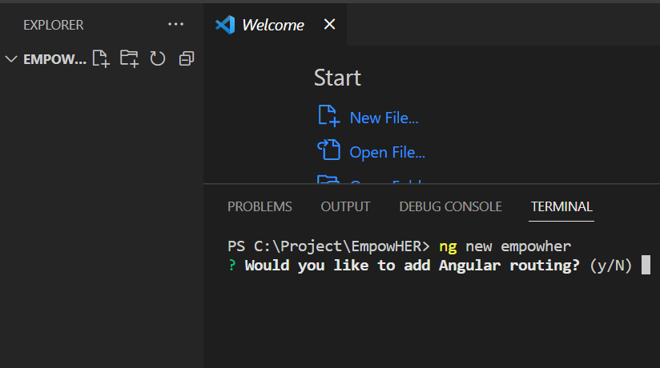
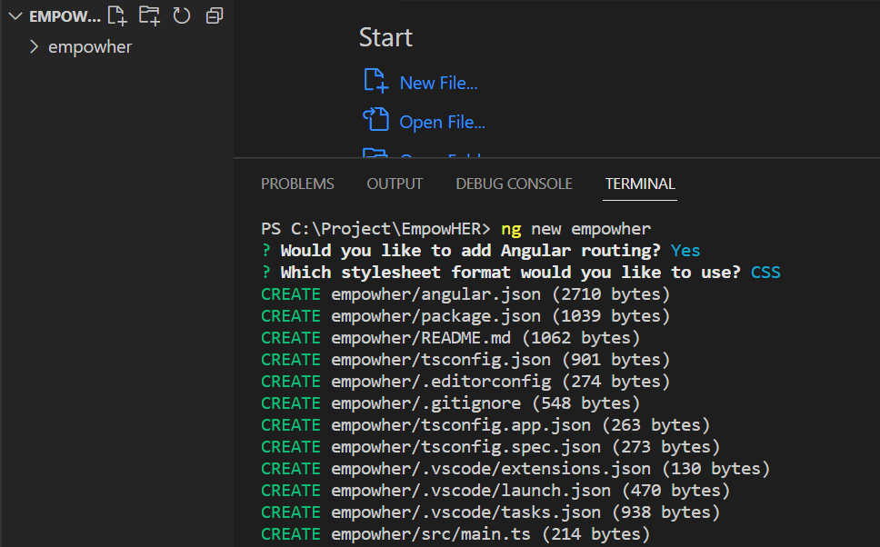
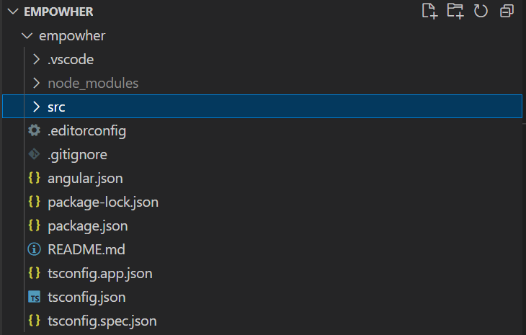
Topic Week 1 : Create a New Angular Project
Step 1 Step 2 Step 3
Type the ng new project-name
In command line.
Select options like routing or CSS
created by ng new.
Explore the generated file structure.

Slide 6
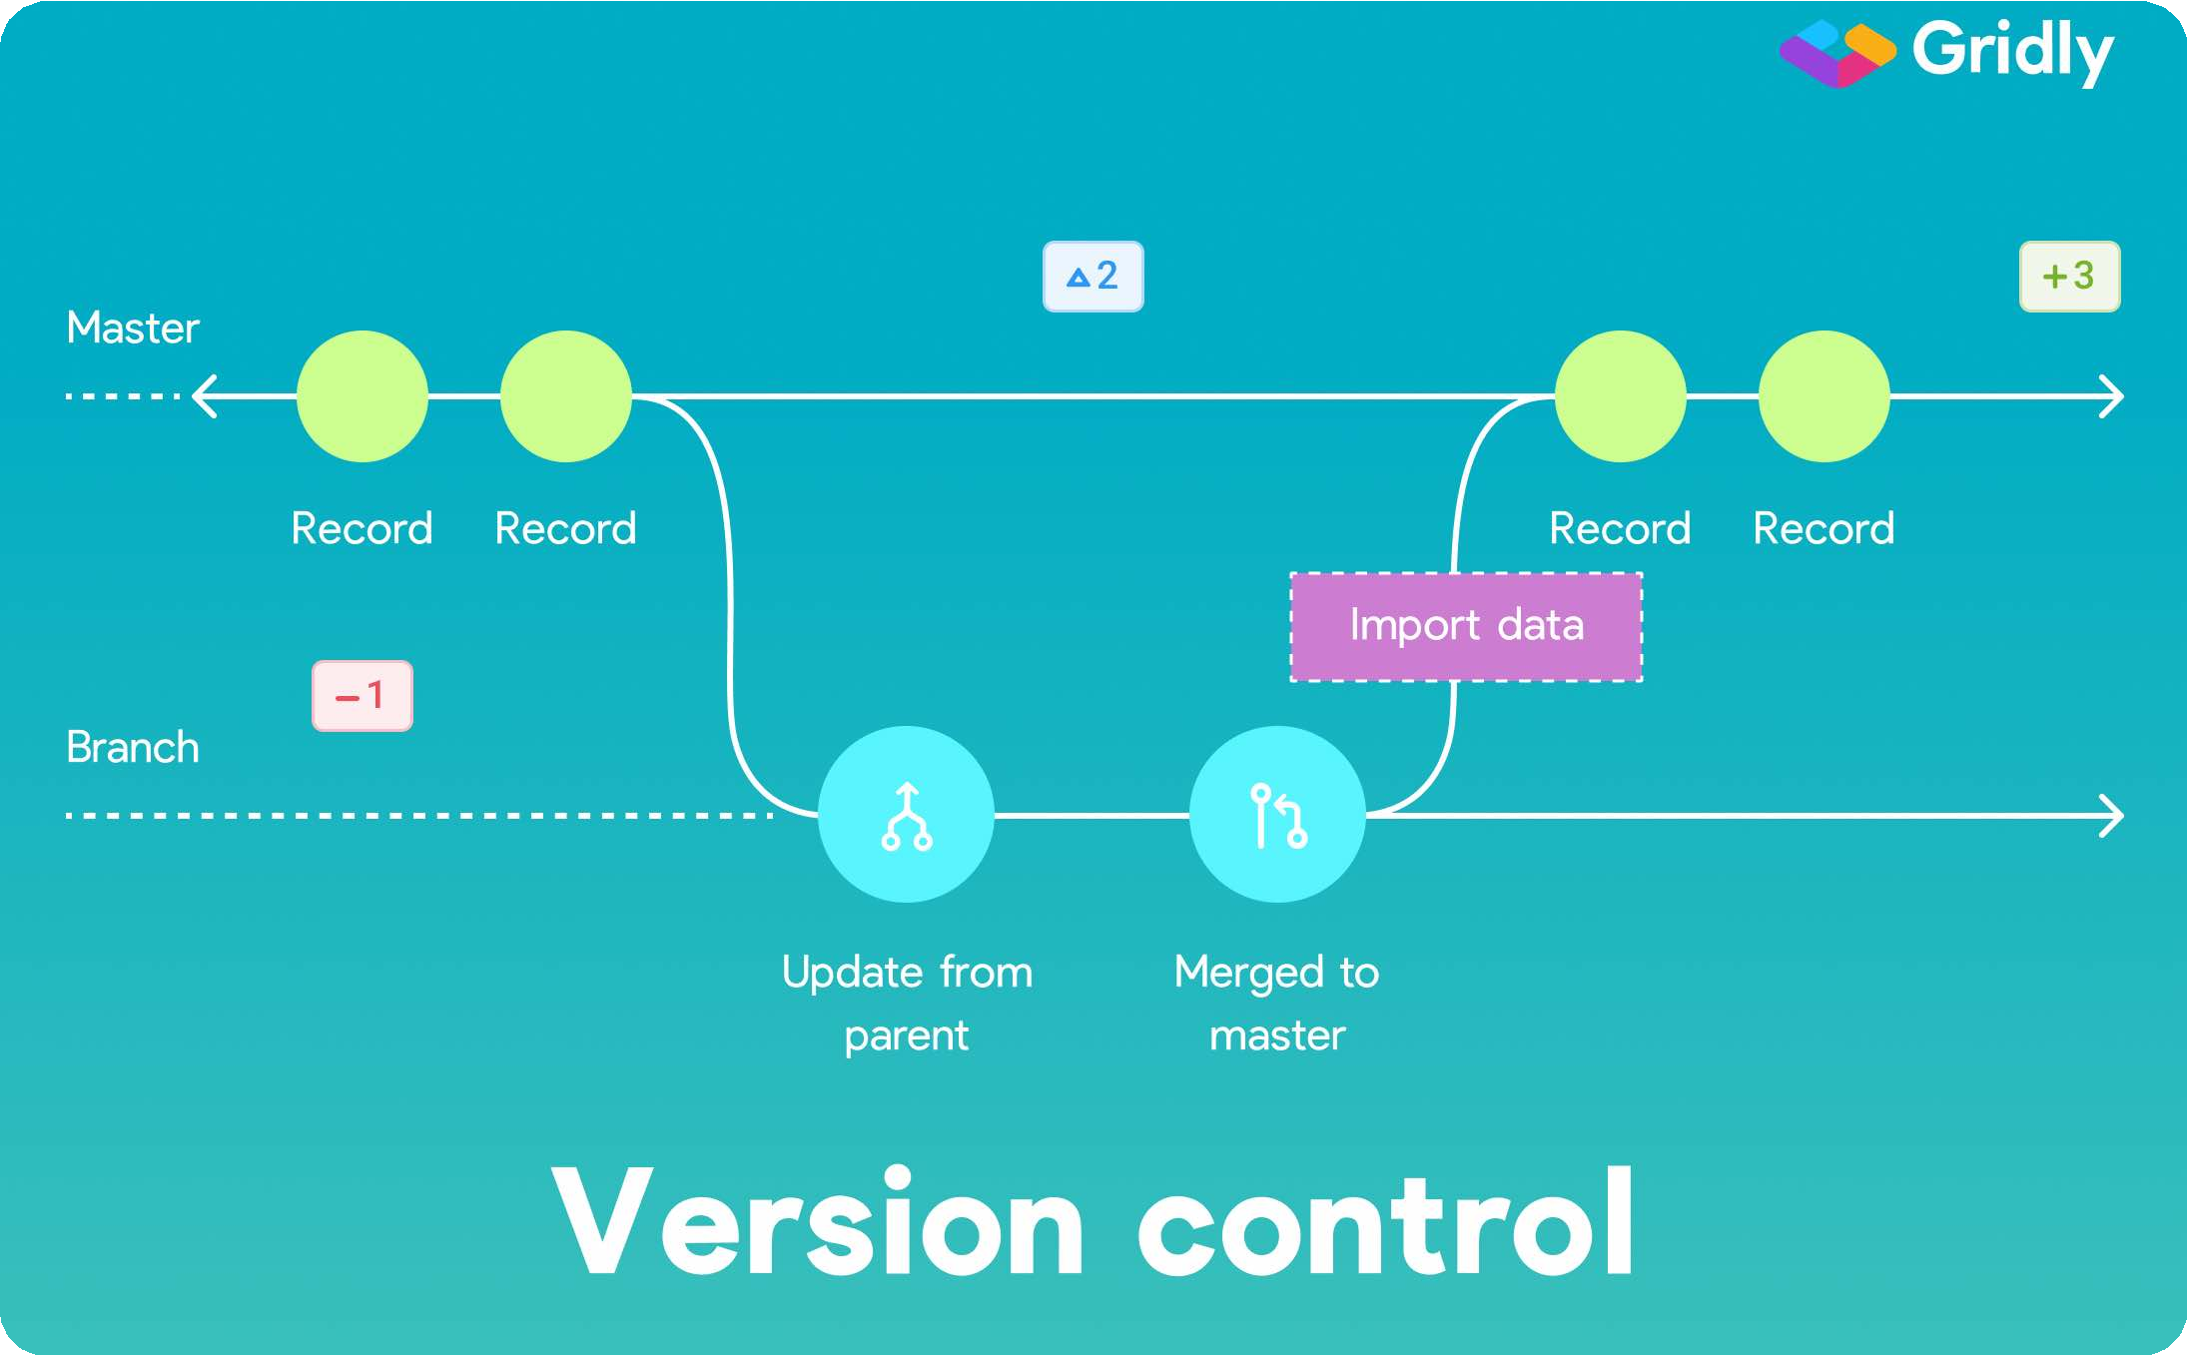

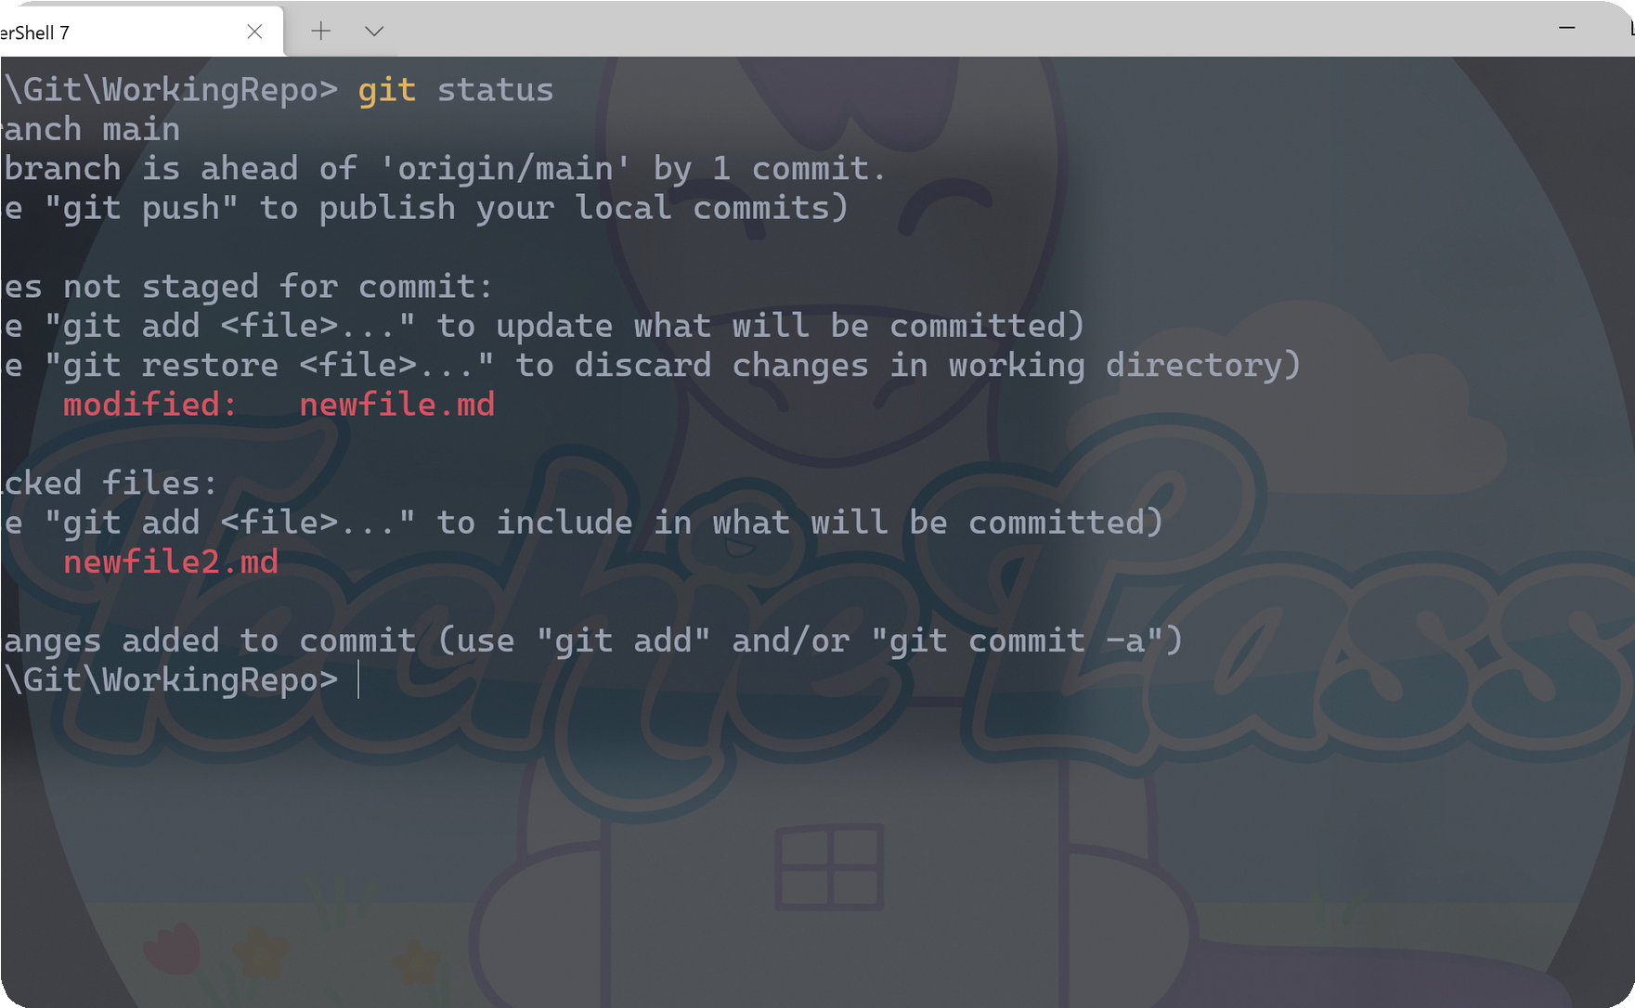
Topic Week 1 : Git and GitHub Basics
Git and Github are essential tools for developers and teams that want to work on projects efficiently and collaboratively.
Version Control
Git provides powerful tools for managing different versions of code, which makes it easier to track changes and manage conflicts.
Collaborating on a Project with Git
Collaborating on projects becomes easier with git. Y ou can collaborate on a project regardless of the location and be sure that everyone has the latest version of the code.
Working with Git Commands
Start working with git and be amazed by its flexibility. T h e s e t u p g u i d e i s g i v e n b e l o w .
Setup Guide : Please click here to open the guide.

Slide 7
Agenda Week 2
HTML
CSS basics
JavaScript
TypeScript

Slide 8
Topic Week 2: HTML
HTML stands for Hyper Text Markup Language
HTML is the standard markup language for creating Web pages
HTML describes the structure of a Web page
HTML consists of a series of elements
HTML elements tell the browser how to display the content
HTML elements label pieces of content such as "this is a heading", "this is a paragraph", "this is a link", etc.

Slide 9
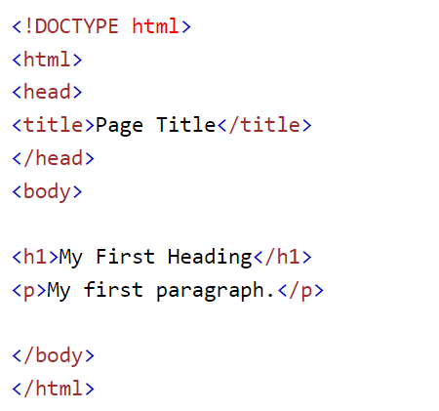
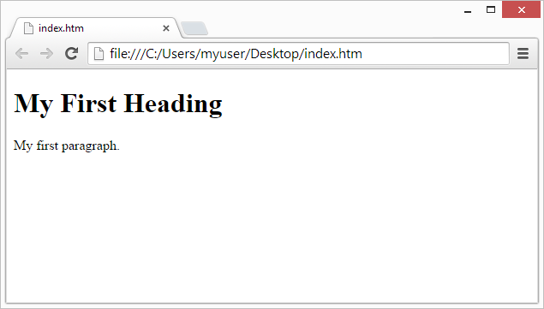
Example
For more information visit - https://www.w3schools.com/html/default.asp

Slide 10
Topic Week 2 : CSS
CSS stands for Cascading Style Sheets
CSS describes how HTML elements are to be displayed on screen, paper, or in other media
CSS saves a lot of work. It can control the layout of multiple web pages all at once
External stylesheets are stored in CSS files
Concepts | Details
Selector | Select which HTML element to style.
Property | Define which aspect of the element to style.
Value | Set the style for the selected element.

Slide 11
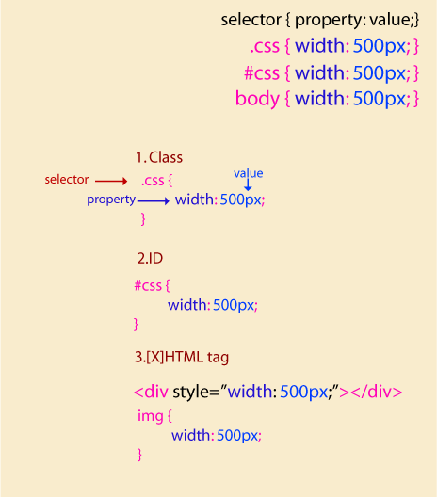
CSS basics
To select elements with a specific class, write a period (.) character, followed by the class name.
To select an element with a specific id, write a hash (#) character, followed by the id of the element.
The element selector selects HTML elements based on the element name such as ‘p’.
The universal selector (*) selects all HTML elements on the page.
For more information visit - https://www.w3schools.com/css/default.asp

Slide 12
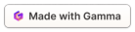
Topic Week 2 : J avaScript F undamentals
Data Types
JS has several primitive data types, such as numbers, strings, and booleans. It also has complex data types such as arrays, objects, and functions.
Functions
A function is a set of statements that perform a task. It can be reused throughout the code.
Loops
Loops are used to repeat a set of instructions until a specific condition is met. There are several types of loops in JS.
Events
Events are actions or occurrences that happen in the browser, such as "click" and "load". Use events to trigger JS code.
For more information visit - https://www.w3schools.com/js/default.asp

Slide 13
Topic Week 2 : TypeScript
Why use TypeScript?
TypeScript helps catch errors before they occur by adding static type checking. It also makes code easier to read and maintain.
1
2
3
What is TypeScript?
How TypeScript is used in angular?
TypeScript is a superset of JavaScript that adds optional types, classes, and interfaces to JS.
Browsers can't execute TypeScript directly. Typescript must be "transpiled" into JavaScript.

Slide 14
Topic Week 3
Angular Folder Structure
Components Life Cycle
Intro to Ng Generate Commands

Slide 15
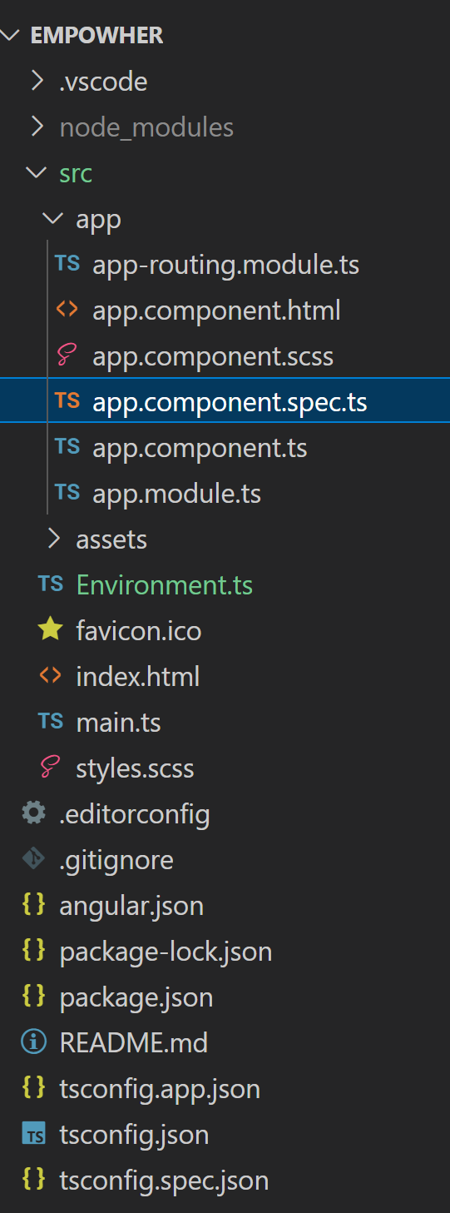
Week3: Angular Project Folder Structure
Angular Project Folder Structure
When you create a new Angular project using the Angular CLI, it generates a specific folder structure:
node_modules: Contains the npm packages necessary for your project.
src: Contains your source files. This is where you'll spend most of your time.
.editorconfig: Configuration for your editor.
.gitignore: Specifies which files should not be tracked by Git.
angular.json: Configuration for Angular CLI. In this file, you can set several defaults and configure
what files are included in your project.
package.json: Lists the packages your project depends on.
tsconfig.json: Configuration for the TypeScript compiler.
tslint.json: Configuration for TSLint.
e2e: Contains end-to-end tests.
In the src/ folder, you'll find:
app: Contains the component files where your application logic resides.
assets: A folder to store images and any static assets.
environments: Contains environment configuration files.
index.html: The main HTML page.
main.ts: The main entry point for your app.
styles.css: Global styles for your app.

Slide 16
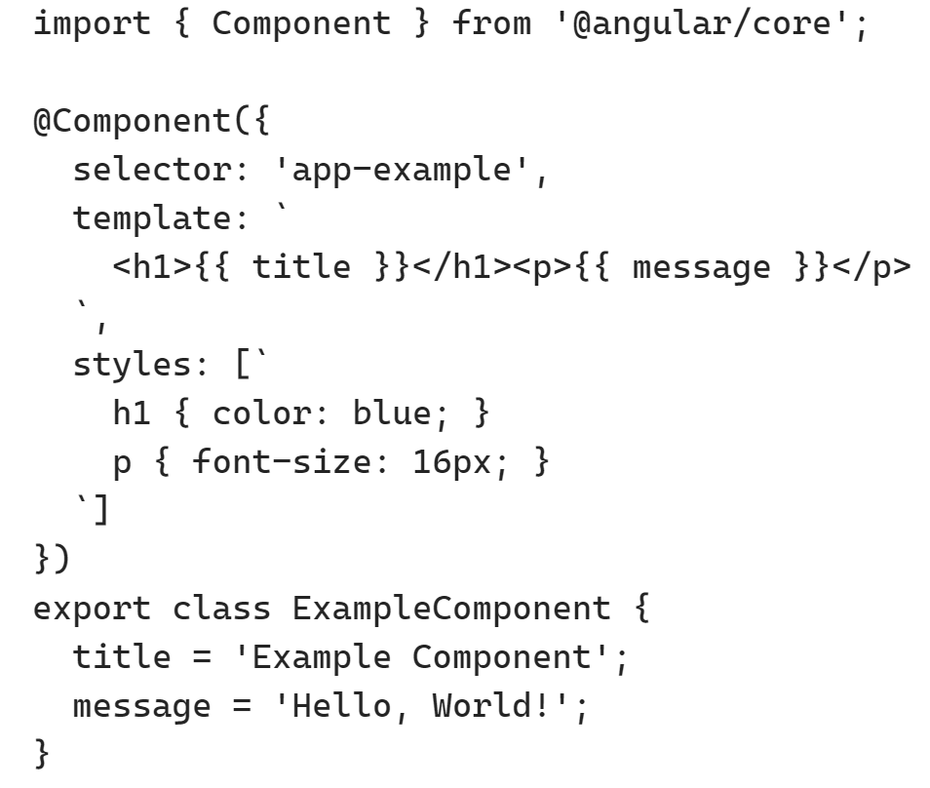
Week 3: Components
Angular components are the building blocks of an Angular application.
They are self-contained and reusable units that encapsulate the
application's logic and user interface.
A component in Angular consists of three main parts:
Template: The template defines the HTML structure and layout of the component.
It contains the markup, bindings, and directives that define how
the component should be rendered.
Class: The class is the TypeScript code that defines the
component's behavior and data.
It contains properties, methods, and lifecycle hooks
that handle the component's functionality.
Metadata: The metadata is defined using decorators, such as @Component,
which provide additional information
about the component.
It specifies the selector (the component's name or tag), the template URL or inline template,
the styles, and other configuration options.

Slide 17
Week 3: Lifecycle
Components are the main building block of an Angular application.
Each component has a lifecycle that it goes through from creation to destruction.
The lifecycle is managed by Angular as it creates, checks, updates, and eventually destroys a component.
Angular provides lifecycle hooks that give visibility into these key life moments and the ability to act when
they occur. Some of the main lifecycle hooks are:
ngOnChanges(): Called before ngOnInit() and whenever one or more data-bound input properties change.
ngOnInit(): Called once the component is initialized.
ngDoCheck(): Called during every change detection run.
ngAfterContentInit(): Called after content (ng-content) has been projected into the component.
ngAfterContentChecked(): Called after every check of component content.
ngAfterViewInit(): Called after the component’s view (and child views) are initialized.
ngAfterViewChecked(): Called after every check of a component's view.
ngOnDestroy(): Called once the component is about to be destroyed.

Slide 18
Week 3: Ng Generate commands
In Angular, the ‘ng generate’ command is used to create various components, modules, services and other files to help build the application. Commonly used ng generate commands are-
Ng generate component component_name
Ex: Ng generate component test
test.component.ts (Class with @Component decorator)
test.component.spec.ts (For test case specification)
test.component.html (For the template)
test.component.css (For stylesheets)
Once the component is created the above 4 files will be created ,there is one file which will be updated called app.module.ts, as we have to reference the newly created component to our root module file so the Angular CLI automatically does the job while generating the component.
Other commonly used ng generate commands are:
ng generate config [type]
ng generate directive [name]
ng generate enum [name]
ng generate environments
ng generate interface [name] [type]

Slide 19
Agenda Week 4
Tip: Use infographics,
Smart Art,
Images/Screens,
Embed relevant learning videos/case study

Slide 20
Topic Week 4

Slide 21
Agenda Week 5
Angular Directives and its types
Using inbuilt directives
Creating custom structural and attribute directives
Angular Pipes
Creating custom pipes
Angular Forms, Template Driven Form

Slide 22
Topic Week 5 - Directives
Directives
Directives are classes with a @directive decorator that add additional behavior to elements in your Angular applications. It helps us to manipulate the DOM. You can change the appearance, behavior, or layout of a DOM element using the Directives. They help you to extend HTML behavior and properties.
Structural
Structural directives can change the DOM layout by adding and removing DOM elements. Eg: ngFor, ngIf, ngSwitch etc.
Attribute
Attribute directives change the appearance or behavior of DOM elements and components. Eg: ngModel, ngClass, ngStyle
Component
A component is a directive-with-a-template; @Component decorator is a @Directive decorator extended with template-oriented features.
Structural Directive
<li *ngFor="let movie of movies"></li>
<movie-detail *ngIf="selectedMovie"></movie-detail>
Attribute Directive
<input [(ngModel)]="movie.name">
Create Directives:
In this section, we will learn how to create directive using Angular CLI command.
To create a directive, use the CLI command-
ng generate directive directive-name
The above command will create the directive inside src/app/directive-name.ts, a corresponding test file .spec.ts and declares the directive class in AppModule.

Slide 23
Topic Week 5 – Attribute Directives
Create Attribute Directives:
Here we will be creating a highlight directive that sets the background color of the host element to yellow.
Run the command: ng generate directive highlight
The @Directive() decorator's configuration property specifies the directive's CSS attribute selector, [appHighlight].
Import ElementRef from @angular/core. ElementRef grants direct access to the host DOM element through its nativeElement property.
Add ElementRef in the directive's constructor() to inject a reference to the host DOM element, the element to which you apply appHighlight.
Add logic to the HighlightDirective class that sets the background to yellow.
To use the HighlightDirective, add a <p> element to the HTML template with the directive as an attribute.
Handling user events:
How to detect when a user mouses into or out of the element and to respond by setting or clearing the highlight color.
Add two event handlers that respond when the mouse enters or leaves, each with the @HostListener() decorator.
Subscribe to events of the DOM element that hosts an attribute directive, the <p> in this case, with the @HostListener() decorator.
Exercise
import { Directive } from '@angular/core’;
@Directive({ selector: '[appHighlight]' })
export class HighlightDirective {
constructor(private el: ElementRef) { this.el.nativeElement.style.backgroundColor = 'yellow’; }
}
Use directive in component template:
<p appHighlight>Highlight me!</p>
import { Directive, ElementRef, HostListener } from '@angular/core’;
@Directive({ selector: '[appHighlight]’ })
export class HighlightDirective {
constructor(private el: ElementRef) {
}
@HostListener('mouseenter') onMouseEnter() { this.highlight('yellow'); }
@HostListener('mouseleave') onMouseLeave() { this.highlight(''); }
private highlight(color: string) { this.el.nativeElement.style.backgroundColor = color;
}}

Slide 24
Topic Week 5 – Structural Directives
Create Structural Directives:
Here we will be creating a highlight directive that sets the background color of the host element to yellow.
Run the command: ng generate directive highlight
The @Directive() decorator's configuration property specifies the directive's CSS attribute selector, [appHighlight].
Import ElementRef from @angular/core. ElementRef grants direct access to the host DOM element through its nativeElement property.
Add ElementRef in the directive's constructor() to inject a reference to the host DOM element, the element to which you apply appHighlight.
Add logic to the HighlightDirective class that sets the background to yellow.
To use the HighlightDirective, add a <p> element to the HTML template with the directive as an attribute.
Handling user events:
How to detect when a user mouses into or out of the element and to respond by setting or clearing the highlight color.
Add two event handlers that respond when the mouse enters or leaves, each with the @HostListener() decorator.
Subscribe to events of the DOM element that hosts an attribute directive, the <p> in this case, with the @HostListener() decorator.
Exercise
import { Directive } from '@angular/core’;
@Directive({ selector: '[appHighlight]' })
export class HighlightDirective {
constructor(private el: ElementRef) { this.el.nativeElement.style.backgroundColor = 'yellow’; }
}
Use directive in component template:
<p appHighlight>Highlight me!</p>
import { Directive, ElementRef, HostListener } from '@angular/core’;
@Directive({ selector: '[appHighlight]’ })
export class HighlightDirective {
constructor(private el: ElementRef) {
}
@HostListener('mouseenter') onMouseEnter() { this.highlight('yellow'); }
@HostListener('mouseleave') onMouseLeave() { this.highlight(''); }
private highlight(color: string) { this.el.nativeElement.style.backgroundColor = color;
}}

Slide 25
Topic Week 5 - Pipes
Pure Pipe
<div>{{ date | localedate: "fr" }}</div>
Attribute Directive
<ul>
<li *ngFor="let n of numbers | sorted">{{ n }}</li>
</ul>
Create Pipes:
In this section, we will learn how to create pipe using Angular CLI command.
To create a pipe, use the CLI command-
ng generate pipe pipe-name
The above command will create the pipe inside src/app/pipe-name.ts, a corresponding test file .spec.ts and declares the pipe class in AppModule.
Pipes
Pipes are to transform strings, currency amounts, dates, and other data for display. Pipes are simple functions to use in template expressions to accept an input value and return a transformed value.
Impure Pipes
Impure pipes are pipes that can detect changes within objects. Changes within objects include things like changing array entries or object properties.
Pure Pipes
A pure pipe is a pipe that is run when a pure change is detected. A pure change is a change to a primitive JavaScript input value like strings, numbers, booleans, symbols or an object reference change.

Slide 26
Topic Week 5 – Pure Pipes & Impure Pipes
Create Pure Pipes:
Here we will be creating a localedate pipe that transform that date format.
Run the command: ng generate pipe localedate
To mark a class as a pipe and supply configuration metadata, apply the @Pipe decorator to the class.
All pipes implement the PipeTransform interface, which specifies that the pipe class must have the transform method. In it, we get the value parameter and then we return a new value derived from it.
We put the pipe name after the variable we want to format in our component template.
Pipes can take arguments. And we can get them from the args parameter in the transform method.
import { Pipe, PipeTransform } from "@angular/core";
@Pipe({
name: "localedate",
})
export class LocaledatePipe implements PipeTransform {
transform(value: Date, ...args: any[]): string {
return value.toLocaleDateString();
}
}
import { Pipe, PipeTransform } from "@angular/core"; @Pipe({
name: "sorted",
pure: false,
})
export class SortedPipe implements PipeTransform {
transform(numbers: number[], ...args: unknown[]): number[] {
return numbers.sort((a, b) => a - b);
}}

Slide 27
Week 5: Angular Forms
Template-Driven Approach
In this method, the conventional form tag is used to create forms. Angular automatically interprets and creates a form object representation for the tag.
Controls can be added to the form using the NGModel tag. Multiple controls can be grouped using the NGControlGroup module.
A form value can be generated using the “form.value” object. Form data is exported as JSON values when the submit method is called.
Basic HTML validations can be used to validate the form fields. In the case of custom validations, directives can be used.
Arguably, this method is the simplest way to create an Angular App.
Reactive Form Approach
This approach is the programming paradigm oriented around data flows and propagation of change.
With Reactive forms, the component directly manages the data flows between the form controls and the data models.
Reactive forms are code-driven, unlike the template-driven approach.
Reactive forms break from the traditional declarative approach.
Reactive forms eliminate the anti-pattern of updating the data model via two-way data binding.
Typically, Reactive form control creation is synchronous and can be unit tested with synchronous programming techniques.

Slide 28
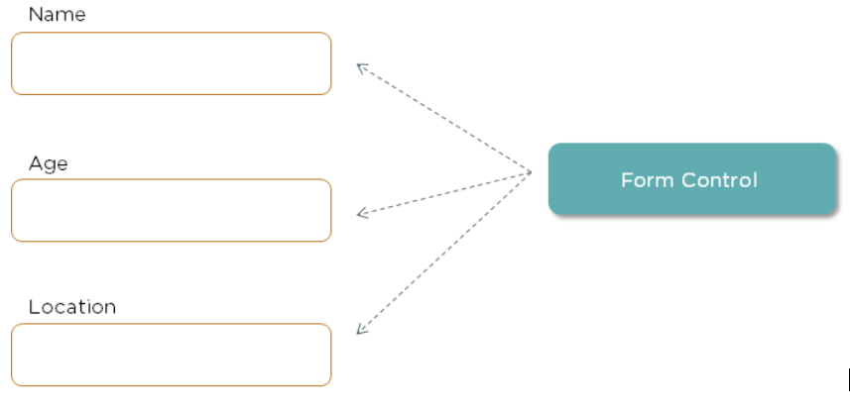
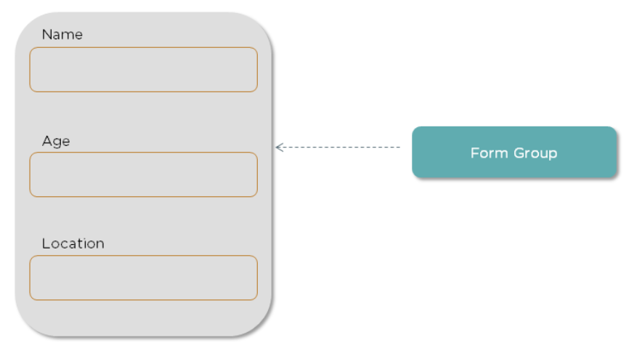
Week 5: Angular Form
Form Control
Form Control is a class that enables validation. For each input field, an instance of this class is created. These instances help check the values of the field and see if they are touched, untouched, dirty, pristine, valid, invalid, and so on.
Form Group
FormGroup class represents a group of controls. A form can have multiple control groups. The Form Group class returns true if all the controls are valid and also provides validation errors, if any.

Slide 29
Week 5: Angular Form – Template Driven
Step 1. Create form Component
Step 2. Create view and Adding Angular Form Controls
Step 3. Getting the JavaScript Object Representation
Step 4. Angular Form Validation
import { Component, OnInit } from '@angular/core';
@Component({
selector: 'app-form-component',
templateUrl: './form-component.component.html',
styleUrls: ['./form-component.component.css']
})
export class FormComponentComponent {
submit(){
console.log("Form Submitted !")
}
}
Exercise
<div class="container">
<h1>User Registration</h1>
<form #login = "ngForm" (ngSubmit)="submit()">
<div class="form-group">
<label for="firstname">FirstName</label><br>
<input type="text" name="firstname" class = "form-control" ngModel>
</div>
<pre></pre>
<div class="form-group">
<label for="email">EmailID</label><br>
<input type="text" name="email" class = "form-control" ngModel>
</div>
<pre></pre>
<div class="form-group">
<label for="password">Password</label><br>
<input type="text" name="password" class = "form-control" ngModel>
</div>
<pre></pre>
<button class="btn btn-primary" type="submit">Submit</button>
</form>
</div>

Slide 30
Agenda Week 6
Angular Forms
Reactive Forms & Validations

Slide 31
Topic Week 6: Reactive Forms
Reactive forms are more explicit, created in component class.
It’s data model is structured.
Predictability of these forms are synchronous.
Form validation of reactive forms are done by functions.
They are more scalable(Low-level API access) and immutable(value change over time).

Slide 32
Topic week 6: Defining form in component class
The structure of the form is defined in the component file, and this structure is synced with HTML code using formGroup directive. So to create a form, we first need to define our form model in the component class.
Form Control is the smallest building block of a reactive form which keeps track of all HTML input value and their validations.
Form Group is a collection of FormControls which combines all the HTML input values into a single object.

Slide 33
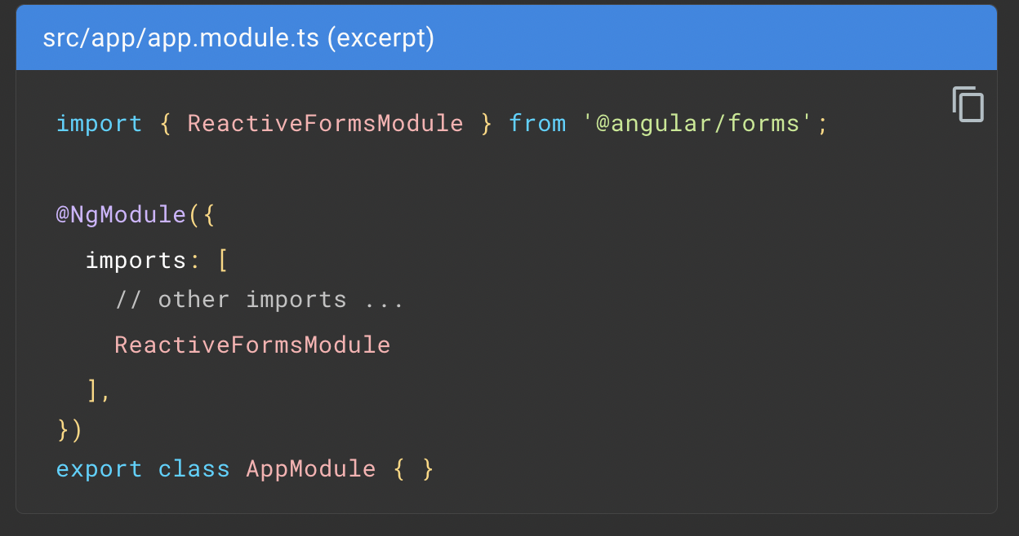
Steps to add a basic form control
Register the reactive forms module
import ReactiveFormsModule from the @angular/forms package and add it to your NgModule's imports array.

Slide 34
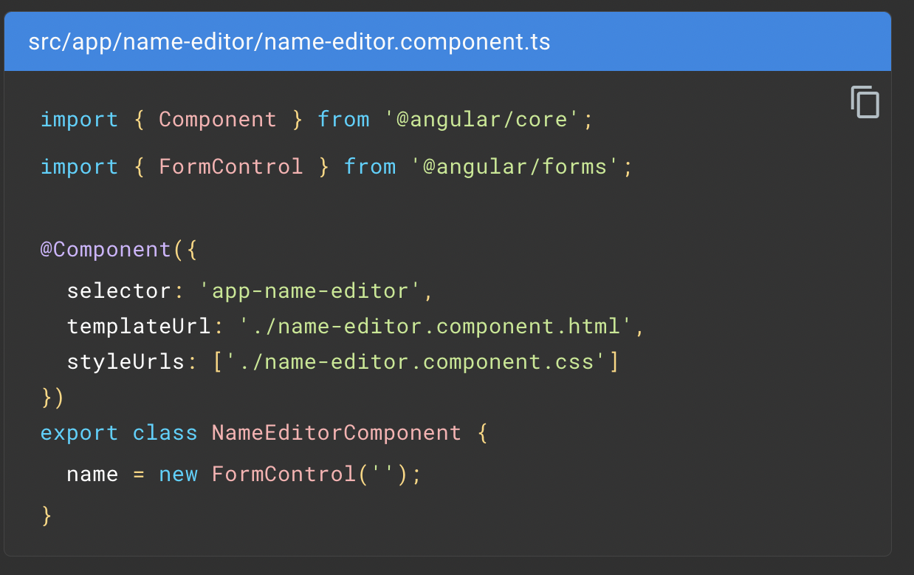
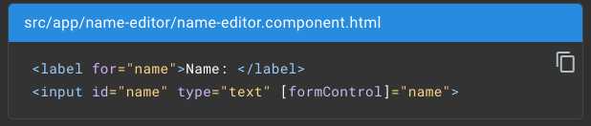
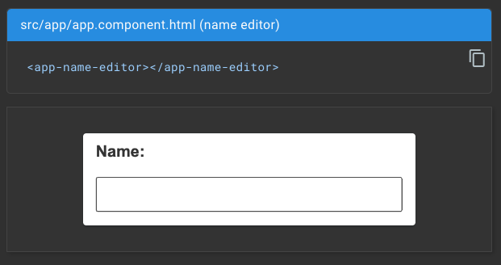
Steps to add a basic form control
2. Generate a new FormControl
Use the constructor of FormControl to set its initial value, which in this case is an empty string.
3. Register the control in the template
Update the template with the form control using the formControl binding provided by FormControlDirective, which is also included in the ReactiveFormsModule.
4. Display the component: The FormControl assigned to the name property is displayed when the property's host component is added to a template.

Slide 35
Grouping form controls
Reactive forms provide two ways of grouping multiple related controls into a single input form.
FORM GROUPS | DETAILS
Form group | Defines a form with a fixed set of controls that you can manage together. You can also nest form groups to create more complex forms.
Form array | Defines a dynamic form, where you can add and remove controls at run time. You can also nest form arrays to create more complex forms.

Slide 36
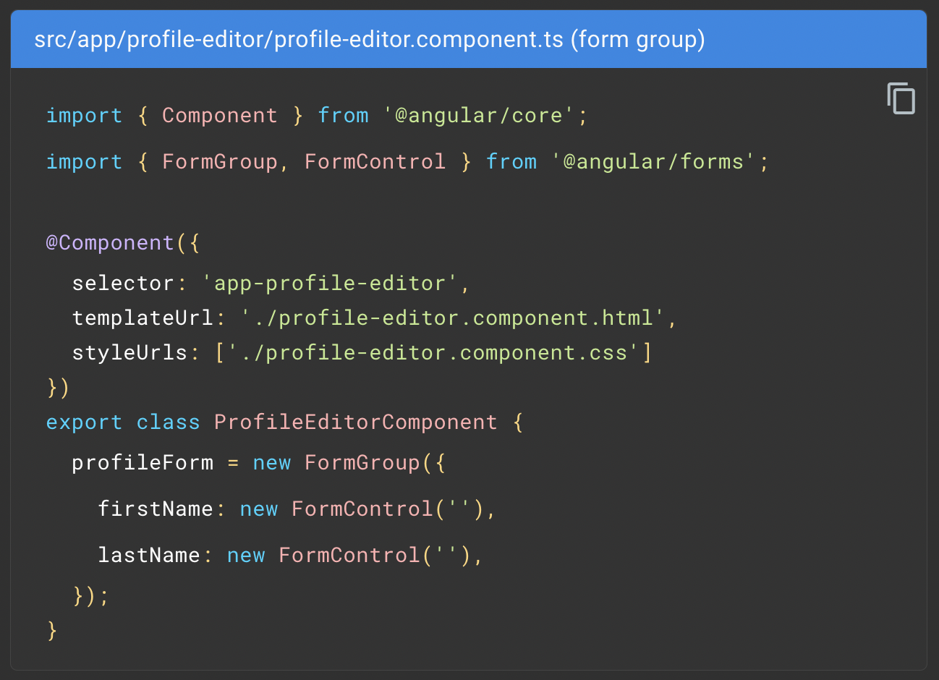
Steps to add form group
Create a FormGroup instance
To initialize the form group, provide the constructor with an object of named keys mapped to their control.
For a profile form, add two form control instances with the names firstName and lastName.

Slide 37
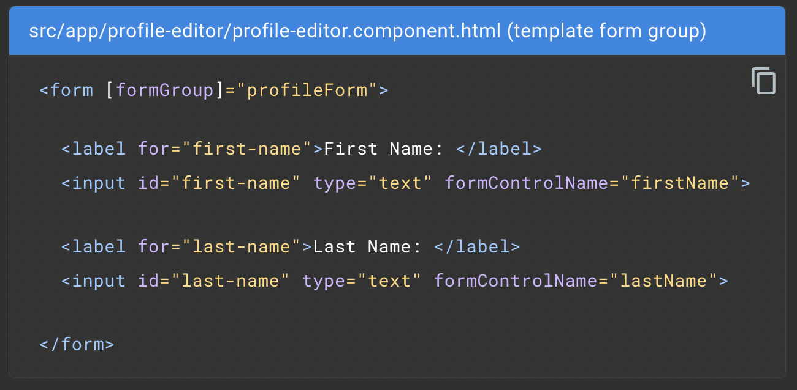
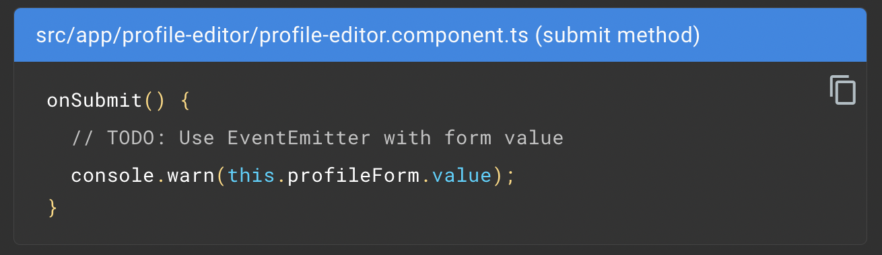
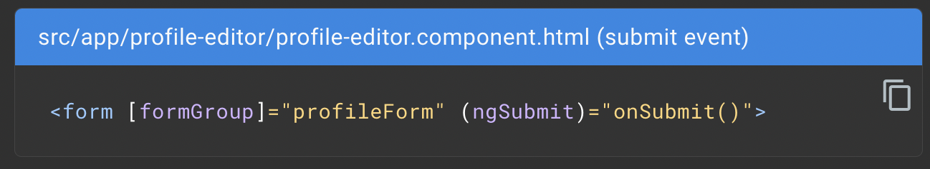
Steps to add form group
2. Associate the FormGroup model and view
3. Save form data

Slide 38
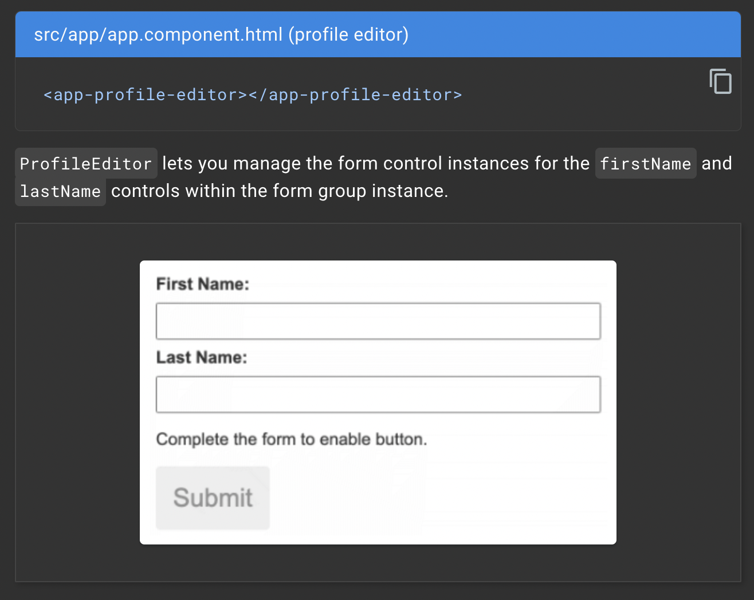
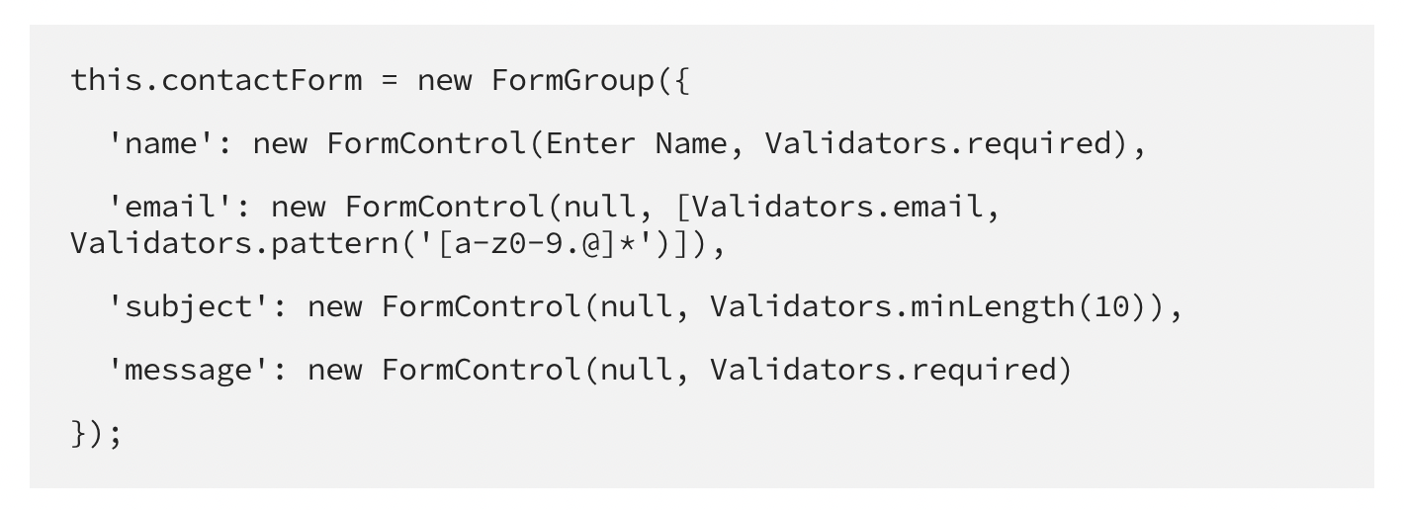
Week 6: Steps to add form group
4. Display the component
5. Adding Validations:
To add validation to a reactive form, we need to import the Validators class from @angular/forms and pass the validation(s)in as a second argument to our FormControl instances.

Slide 39
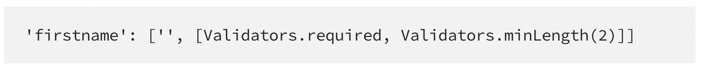
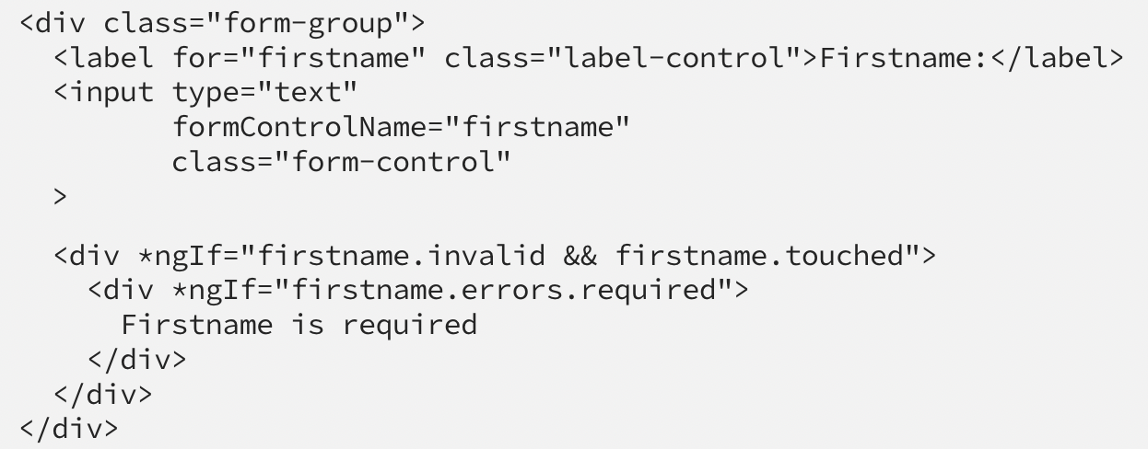
Week 6: Adding Validations
When we need to use more than one validator, we make the second parameter an array like below:
Displaying Validation Error

Slide 40
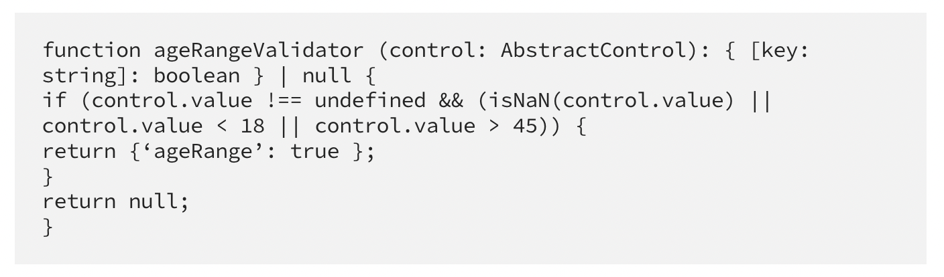
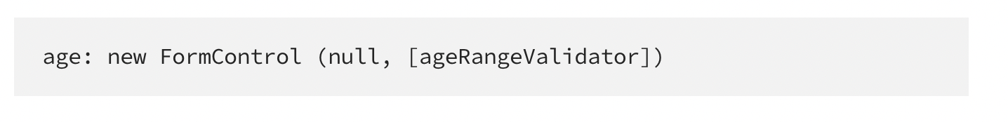
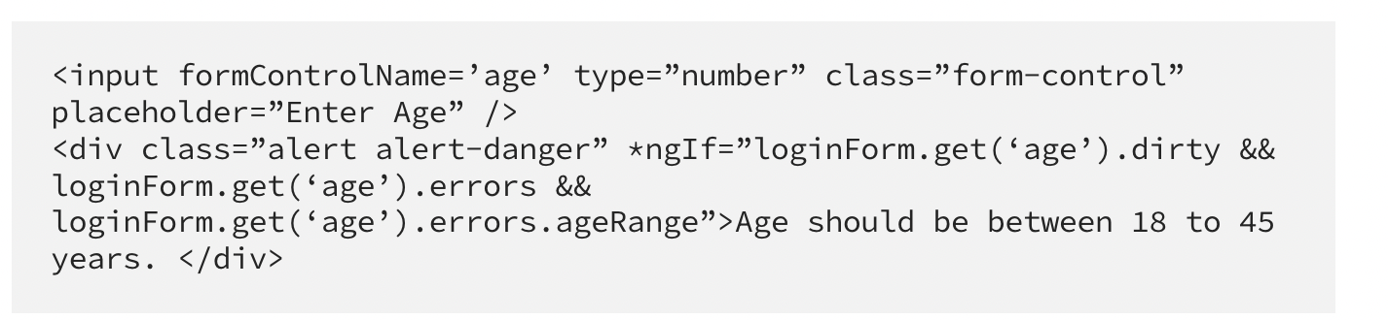
Week 6: Custom Validators
Create ageRangeValidator custom validator in class file:
2. Pass new FormControl in FormGroup(class file)
3. Pass validation in Form(HTML file):

Slide 41
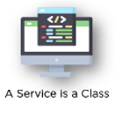

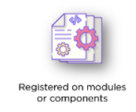
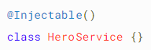
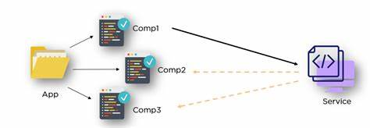
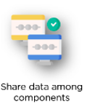

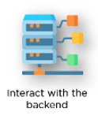
Agenda Week 7 - Angular Services
A service is typically a class with a narrow, well-defined purpose. A service can be any value, function, or feature that an application needs. It should do something specific and do it well.
Why We should use Service ?

Slide 42
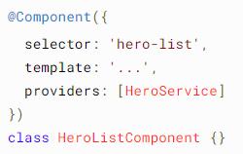
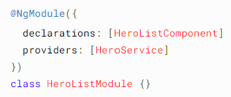
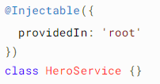

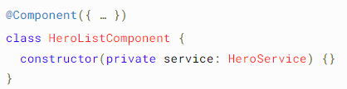
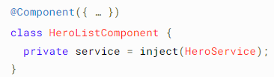
Agenda Week 7 - Angular DI
Dependency injection (DI) provides components a way to access services and other resources.
Providing dependency
OR OR
Injecting a dependency
OR

Slide 43
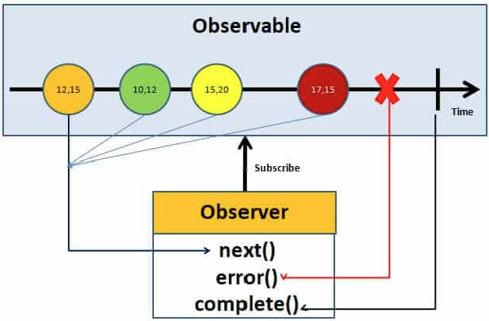
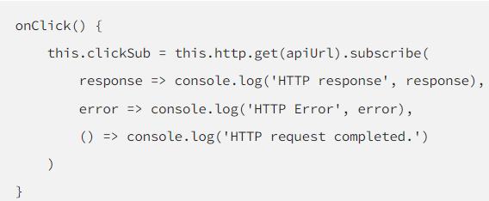
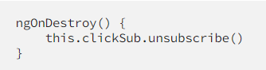
Agenda Week 7 - Angular Observable and Http
Observable is like a data source. It is from Rxjs.
Implemented by following an observable pattern. where we have an observable and an observer and in between, we have a timeline where we can have multiple events, or data packages, emitted by the observable.
HttpClient service is available as an injectable class, with methods to perform HTTP requests. Each request method has multiple signatures, and the return type varies based on the signature that is called
Subscribing to an Observable Un-Subscribing to an Observable

Slide 44
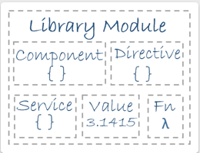
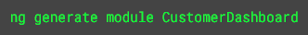
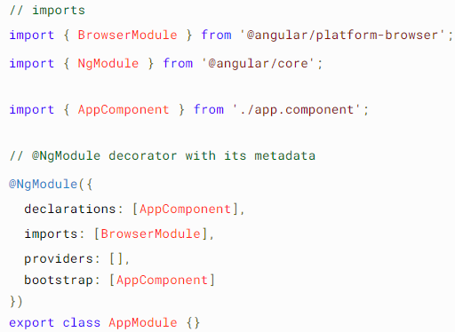
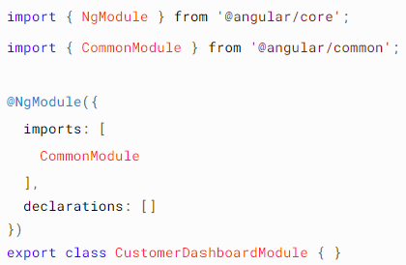
Agenda Week 8 – Angular Modules
Angular has its own modularity system called NgModules. NgModules are containers for components, service providers, and other code files whose scope is defined.
Every Angular application has at least one Generate Module Using Angular CLI NgModule class, app.module.ts

Slide 45
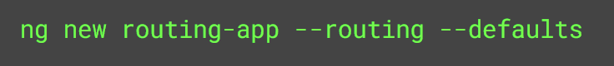
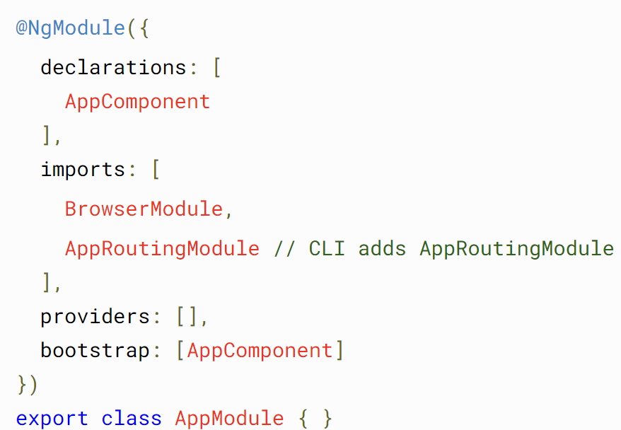
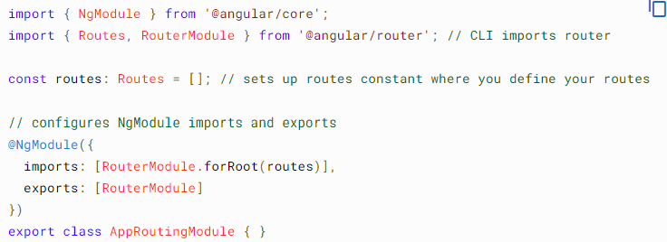
Agenda Week 8 – Angular Routing
To handle the navigation from one view to the next, you use the Angular Router. The Router enables navigation by interpreting a browser URL as an instruction to change the view.
Generate Routings with Angular CLI
Changes to the App Module CLI Generated Routing module

Slide 46
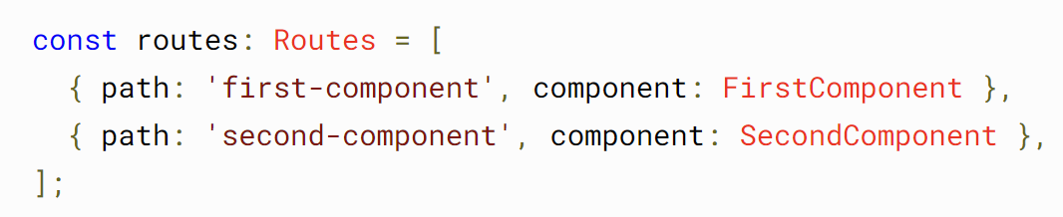


Agenda Week 8 – Angular Routing
Configuring the Routes
Setting up redirections
Configuring the Wild Cards or Display 404 page.
Lazy Loading

Slide 47




Agenda Week 9 – Angular Unit Testing.
Testing your Angular application helps you check that your application is working as you expect.
You can Test Components, Services, Directives, Pipes, Routes, etc.
Setting Up Tests Project you create with the CLI is immediately ready to test. Just run the CLI command
Console output looks the below Browser output looks the below
Find the Code Coverage with CLI Command

Slide 48
Topic Week 9

Slide 49
Agenda Week 10
Tip: Use infographics,
Smart Art,
Images/Screens,
Embed relevant learning videos/case study

Slide 50
Topic Week 10

Slide 51
Appendix
Add Links or permissible Images as needed

